Slide 1
Identifying Connectivity Patterns for Brain Diseases via Multi-side-view Guided Deep Architectures
Jingyuan Zhang¹, Bokai Cao¹, Sihong Xie¹,
Chun-Ta Lu¹, Philip S. Yu^{1,2}, Ann B. Ragin³
1. University of Illinois at Chicago
2. Tsinghua University
3. Northwestern University

Slide 2
Outline
Introduction & Motivation
Data Analysis
Methodology
Experiments
Conclusions

Slide 3
Introduction
Mining neuroimage data
Detect neurological disorders
Problems
Connectivities of brain regions
Interpretation of disease mechanisms

Slide 4
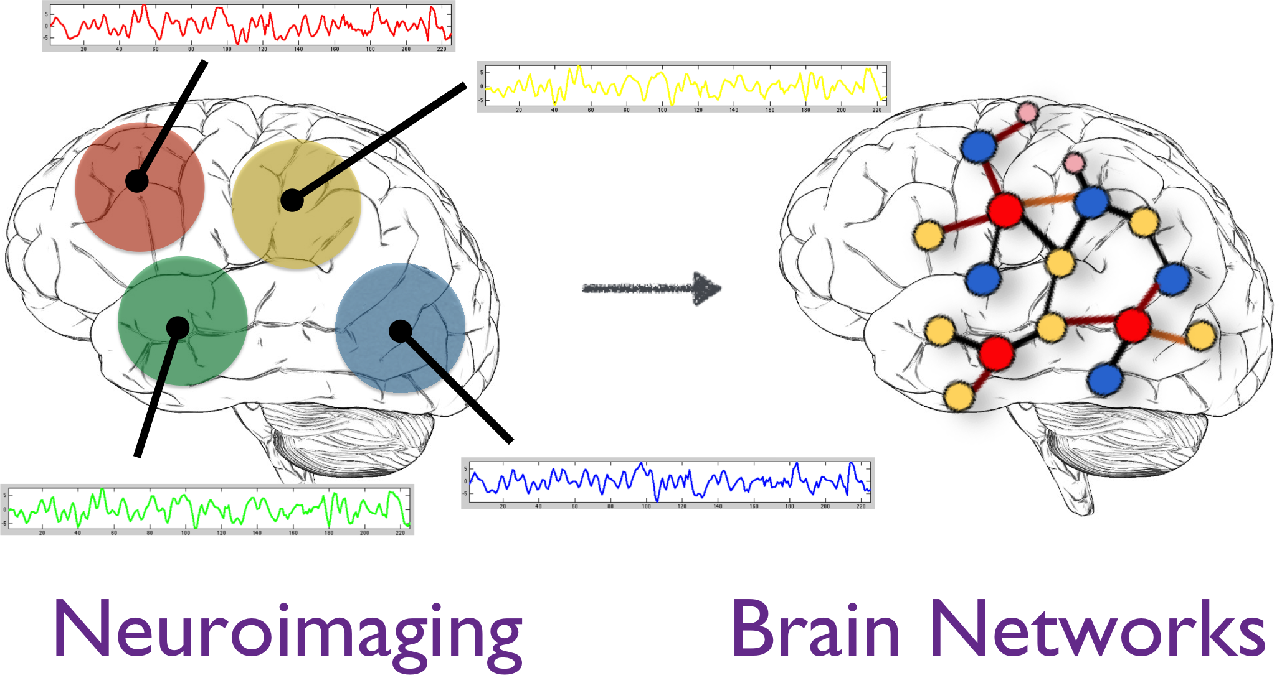
Introduction
Mining brain networks
Discover clinically meaningful patterns

Slide 5
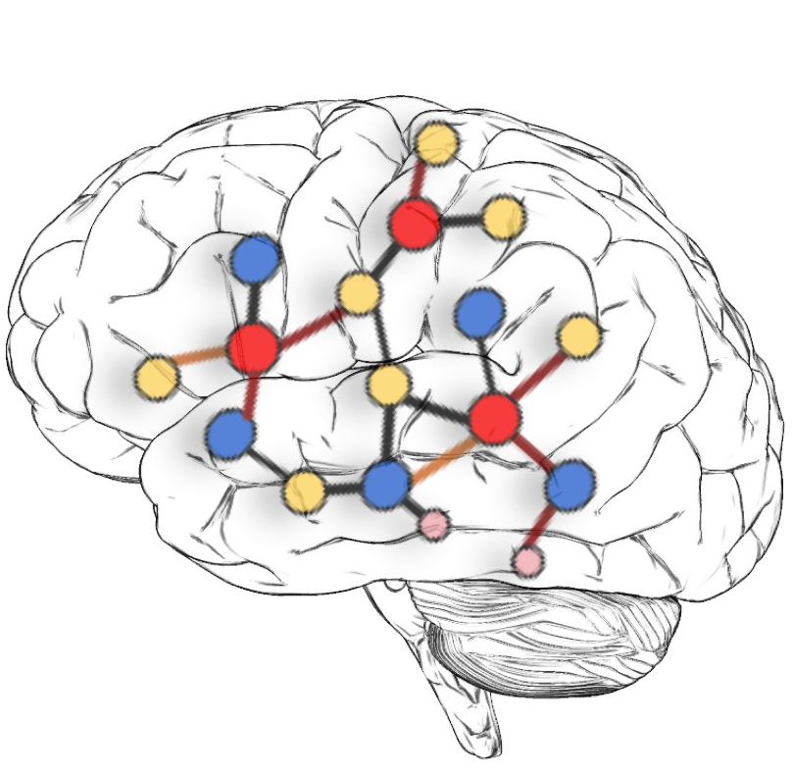
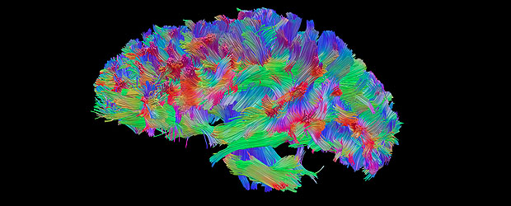
Introduction
Brain networks
Nodes: brain regions
e.g., insula, hippocampus
Edges: connections of brain regions
fMRI: correlations between brain regions in functional activity
DTI: number of neural fibers connecting brain regions
fMRI
DTI

Slide 6
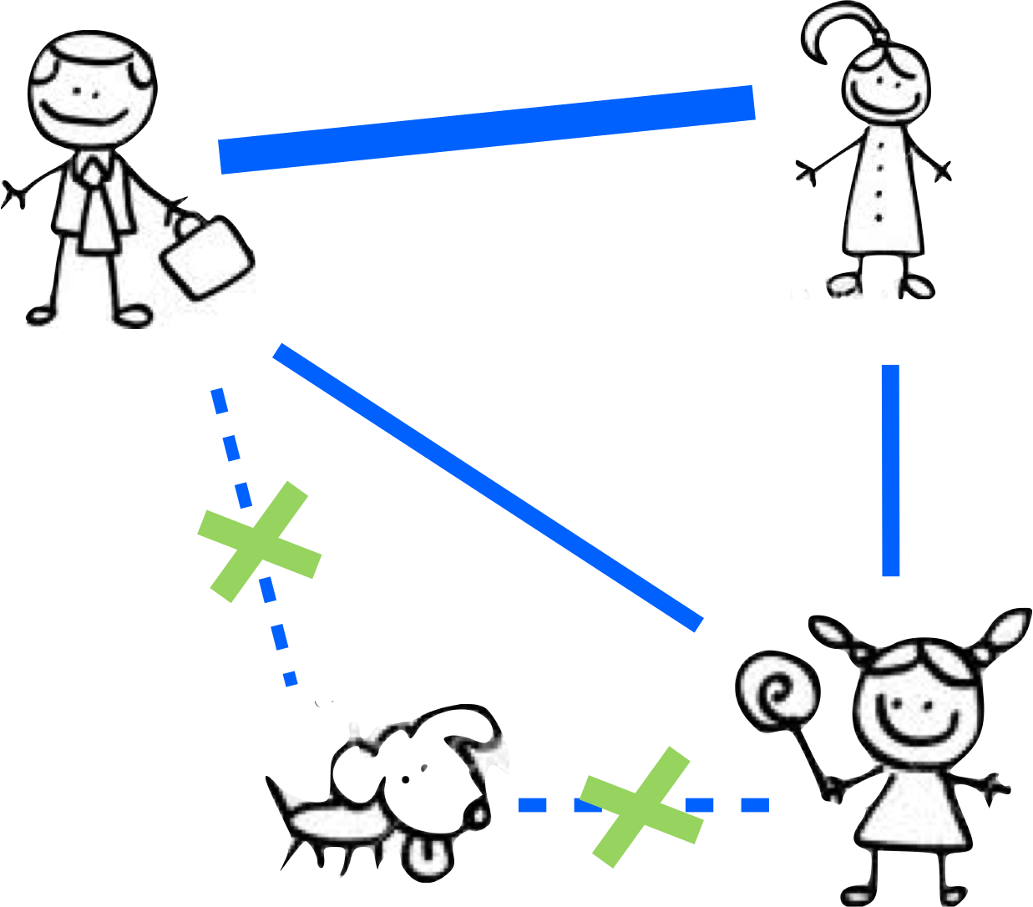
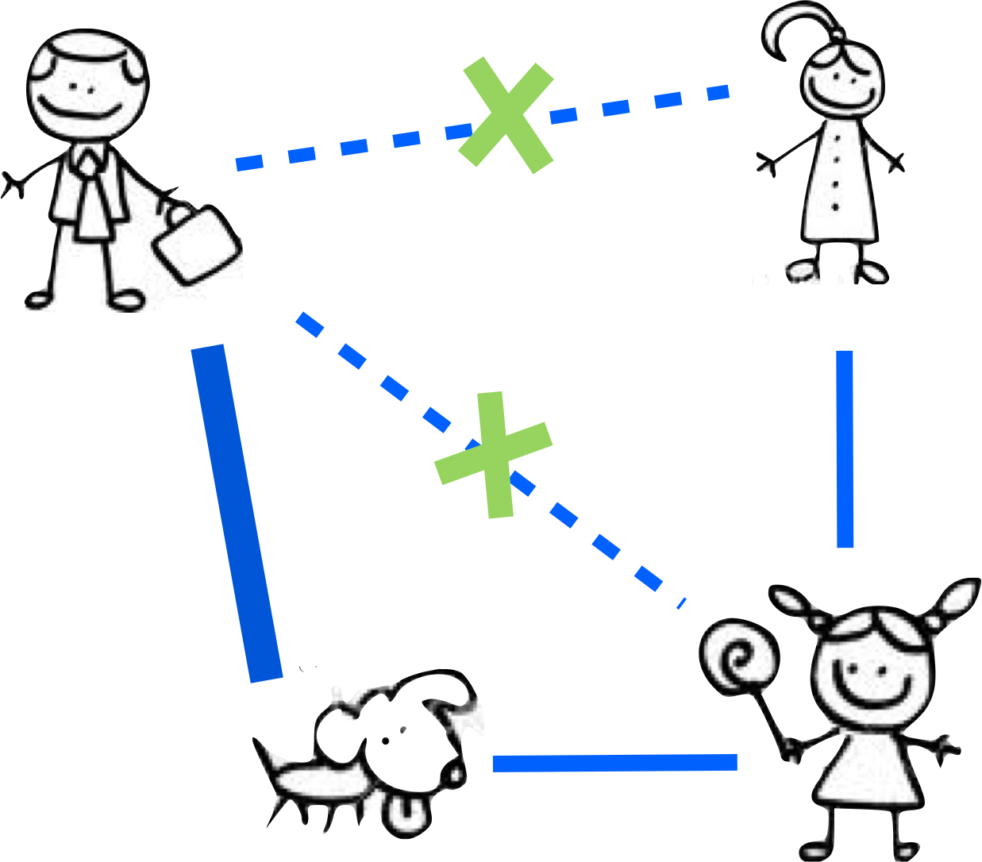
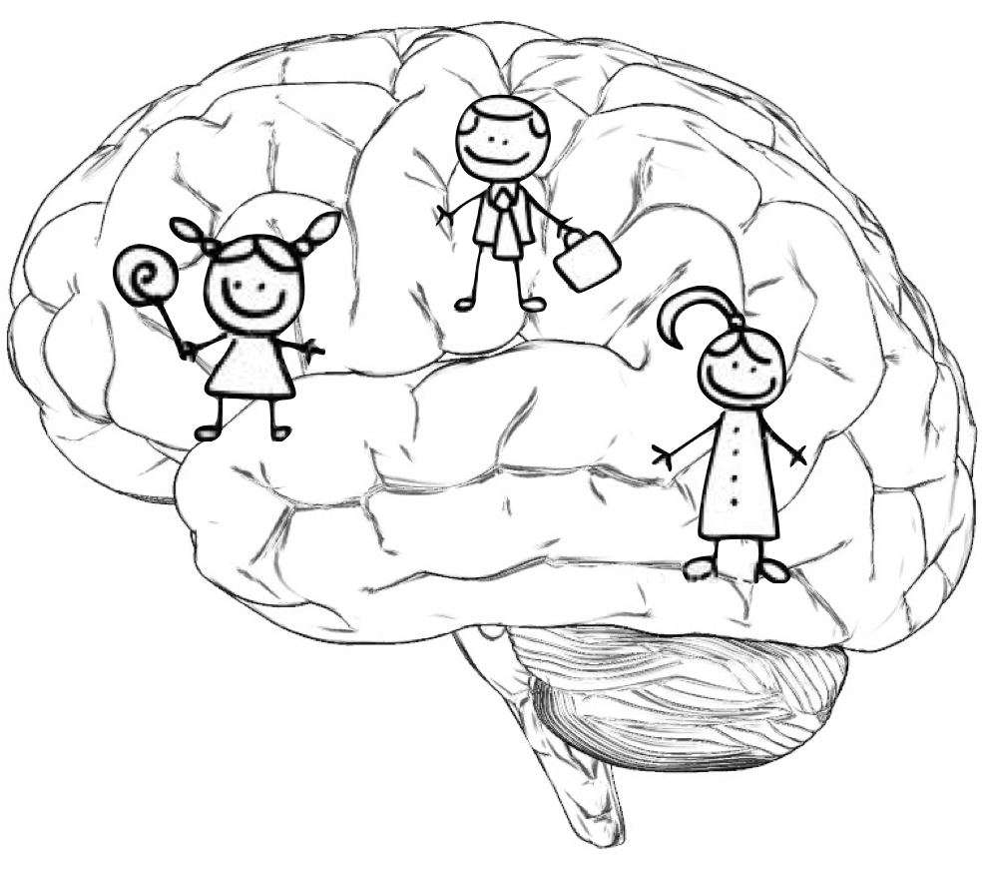
Introduction
Mining brain networks
Connected subgraph patterns
Problems
Interplay among patterns
Healthy
brain
Diseased
brain

Slide 7
Motivation
Deep learning architectures
Non-linear representations of patterns
Difficulties
Limited subjects & high costs
Multiple side views
Other sources of auxiliary data
Clinical, serologic, immunologic, etc.

Slide 8
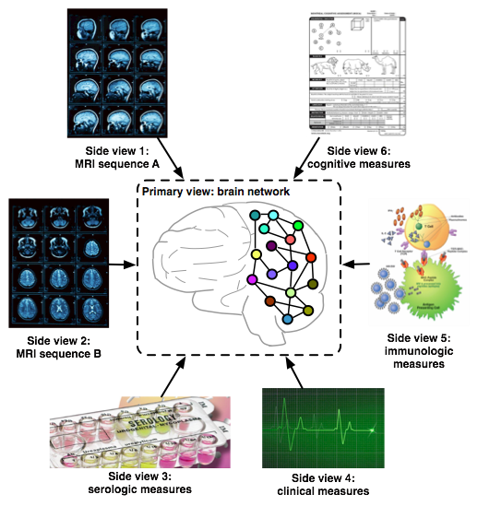
Motivation
Tackle the bias of scarce data
Incorporate multiple side views
Guide the representation learning
Why not
a simple concatenation?

Slide 9
Motivation
A simple concatenation
Mixture features
Difficulty of interpretation
Our basic idea
Pairwise similarities from side views
Patterns w.r.t the geometry of side views
Are the multiple side views really
useful in guiding deep learning?

Slide 10
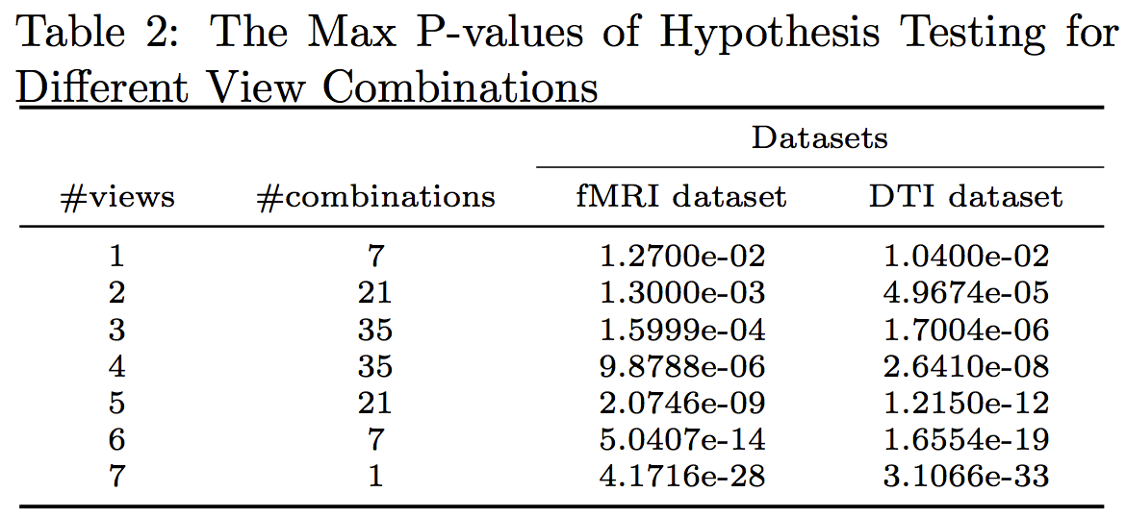
Data Analysis
Multi-side-view guidance
Consistency between side views and
pre-specified label information
Two-sample one-tail t-test
Similar instances under side views
Similar labels, both positive or negative
Significance level 0.05

Slide 11
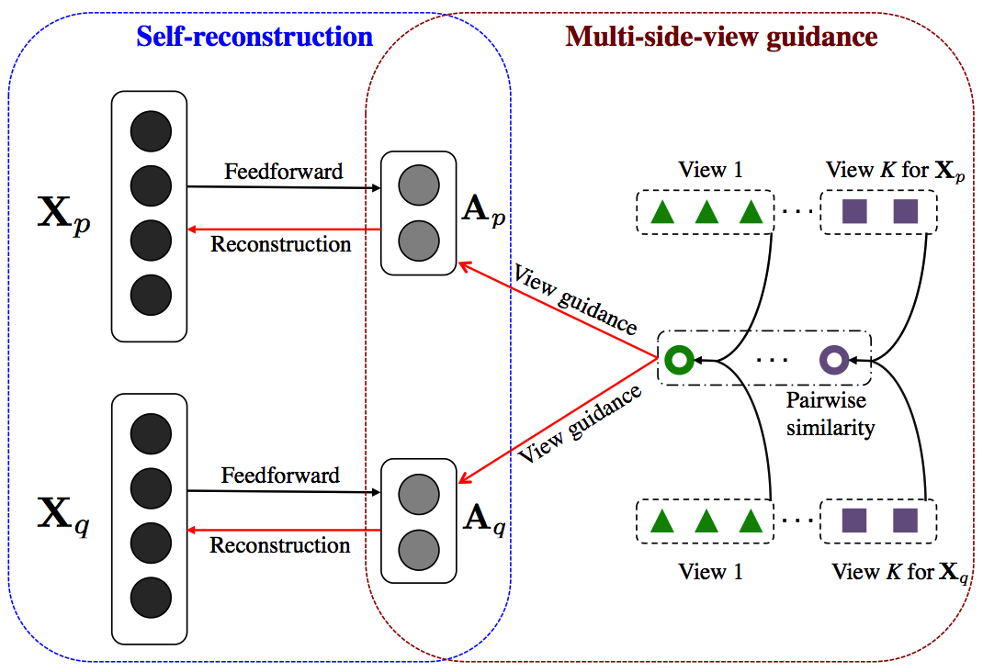
Methodology
MVAE
Multi-side-View guided AutoEncoder

Slide 12
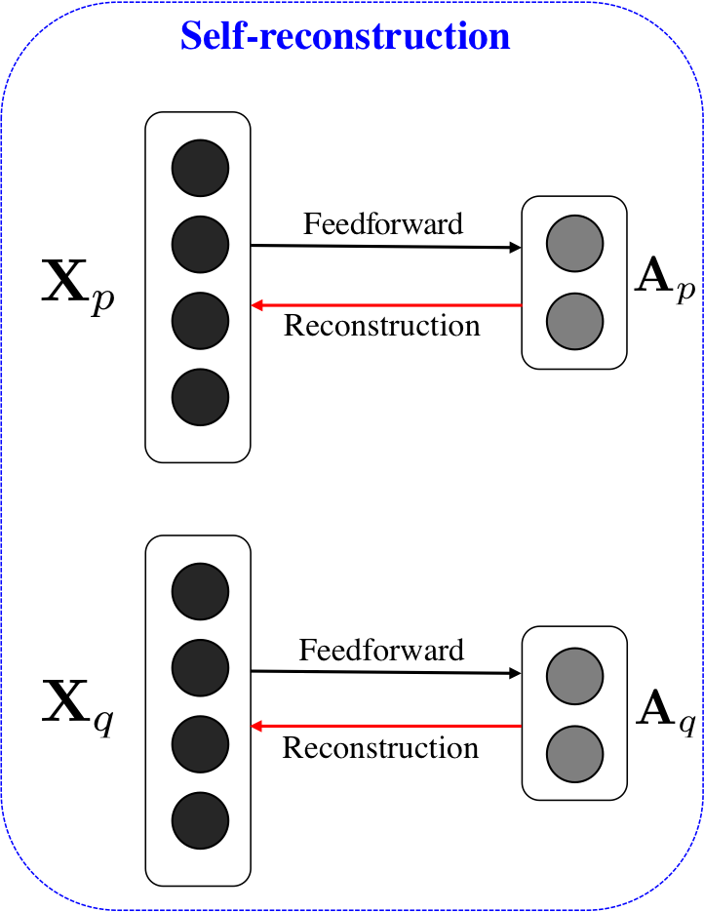
Methodology
The classic autoencoder (AE)
Self-reconstruction criterion
Unsupervised feedforward NN
Fit input with the reconstructed output

Slide 13
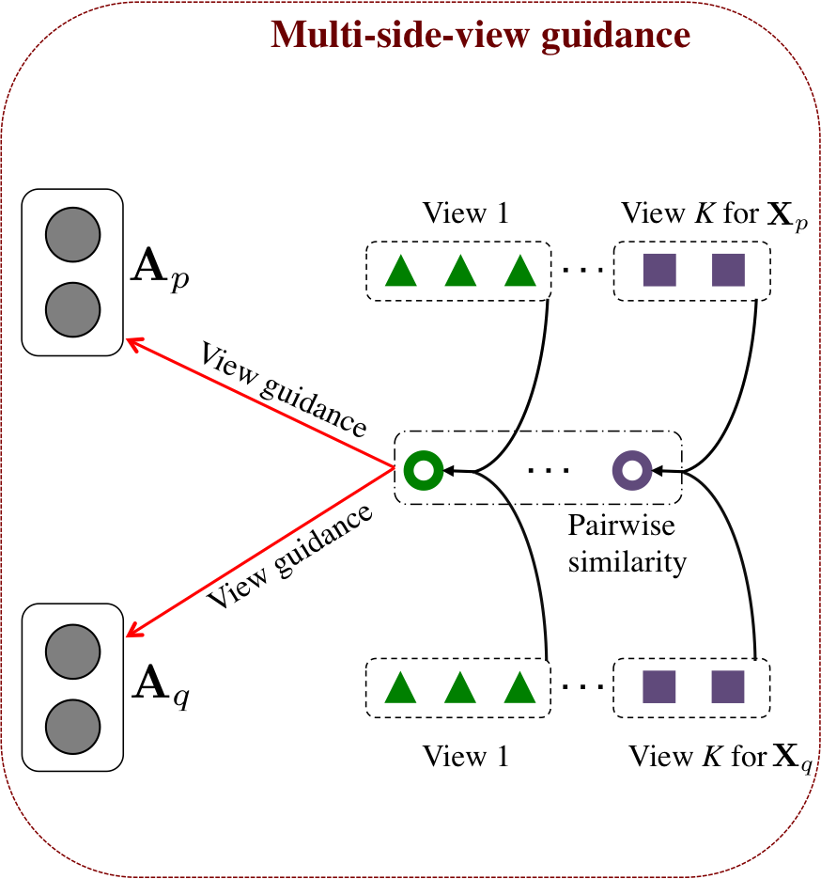
Methodology
Multi-side-view guidance
Encapsulate side views into AE
Pairwise relationship of learned features
Consistent with that of the side views

Slide 14
Methodology
Objective function of MVAE
Average of
reconstruction
error
Regularization
to prevent
over-fitting
Guiding
parameter
Sparsity term
to
reduce noise
Multi-side-view guidance term

Slide 15
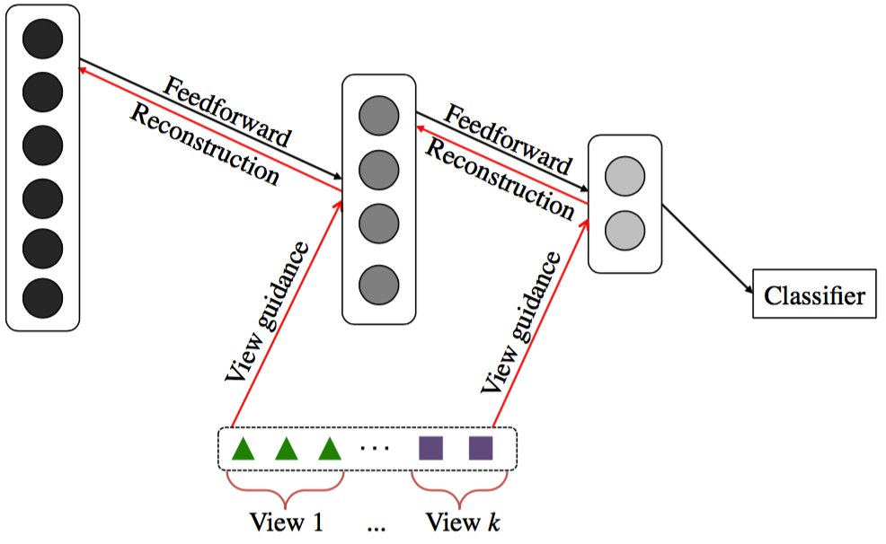
Methodology
Build deep architectures
Stacked MVAE
Greedy layer-wise pre-training
Supervised fine-tuning

Slide 16
Experiments
Data collection
Chicago Early HIV Infection Study
56 HIV and 21 normal controls
Brain networks
From fMRI and DTI images
Seven side views
Neuropsychological tests
Flow cytometry
Plasma luminex
...

Slide 17
Experiments
Baselines
Subgraph
Mining
Deep
Learning
No side-view guidance
No side-view guidance
1. gSSC
2. Freq
3. Conf
4. Ratio
5. Gtest
6. HSIC
AE-1
gMSV
MVAE-1
Side-view guidance
Side-view guidance

Slide 18
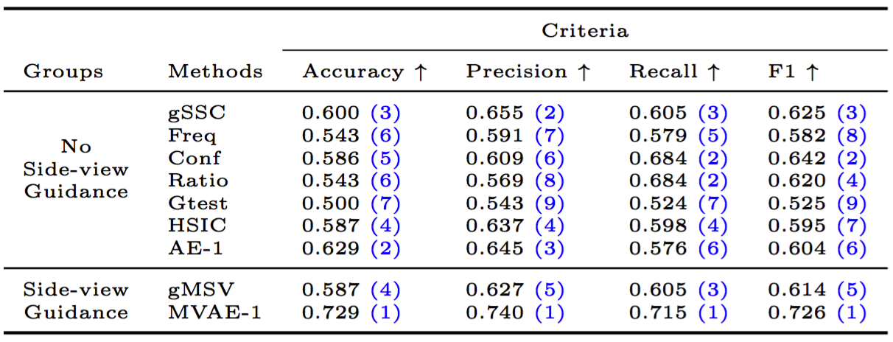
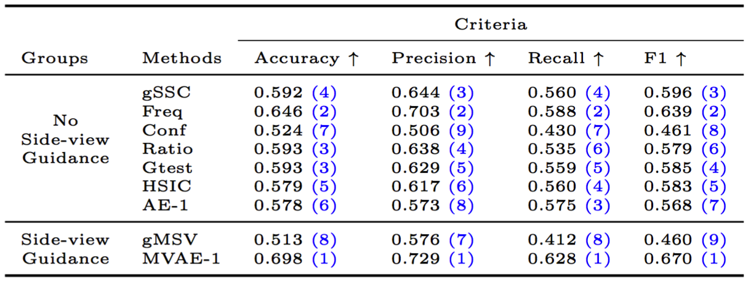
Experiments
fMRI
DTI

Slide 19
Experiments
Performance of stacked MVAE
MVAE-2 performs the best
MVAE-3 may over fit the limited data

Slide 20
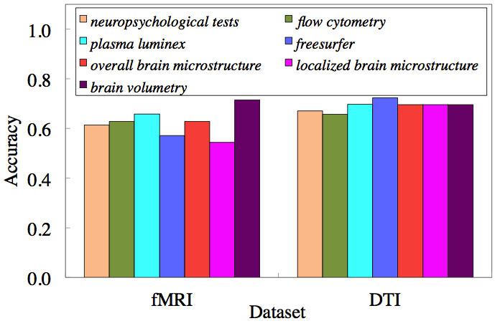
Experiments
Performance with each side view
Brain volumetry
Plasma luminex

Slide 21
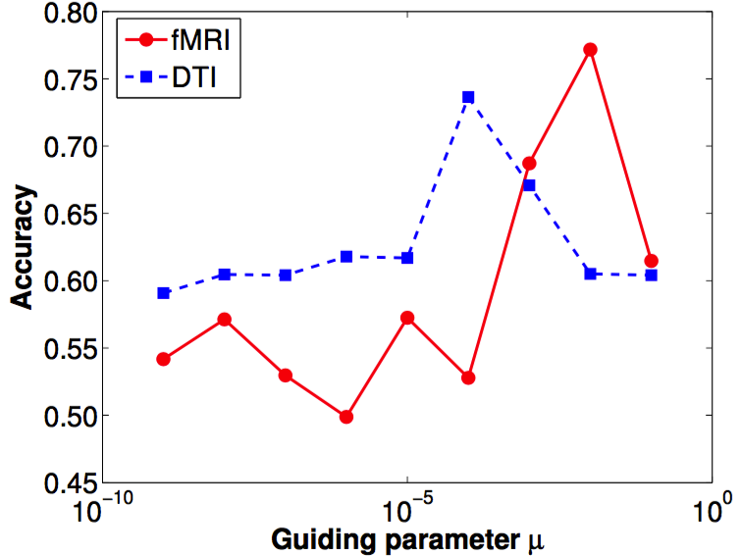
Experiments
Analysis of the guiding parameter
Relative importance of side views

Slide 22
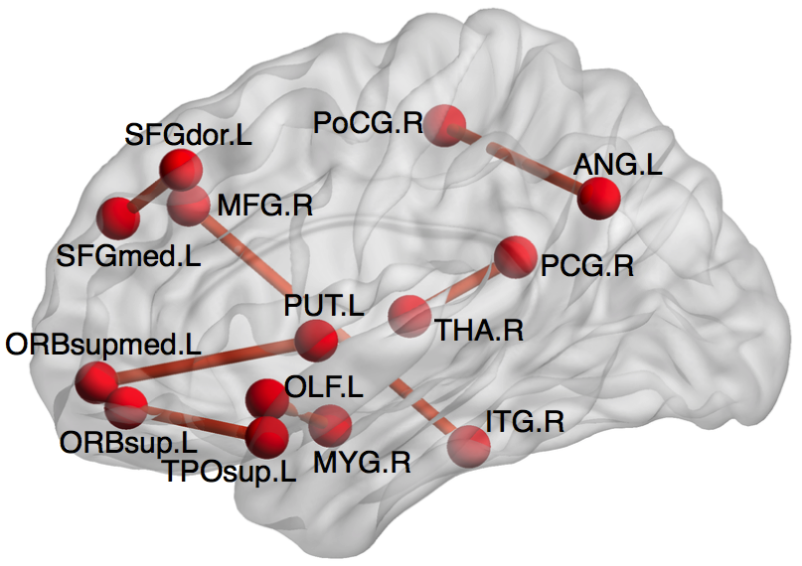
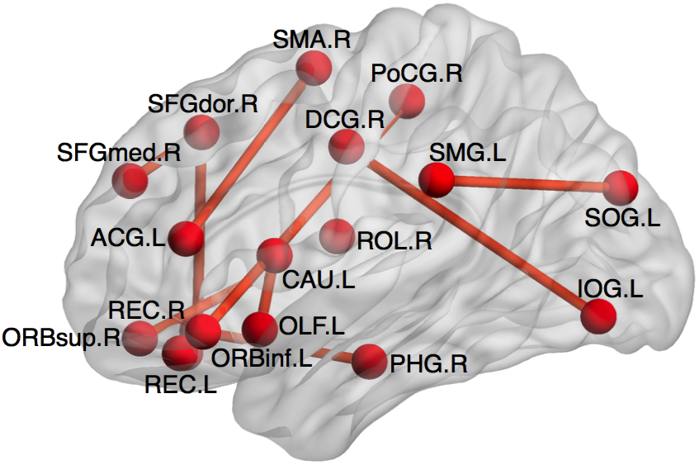
Experiments
Visualization on fMRI data
Each neuron in the first hidden layer
A discriminative connectivity pattern
Two most significant connectivity patterns

Slide 23
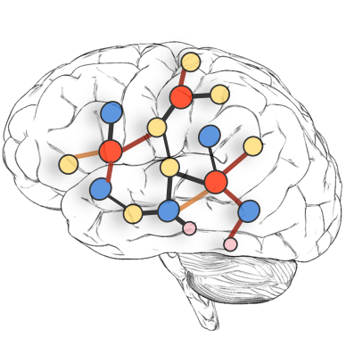
Conclusions
Identify brain connectivity patterns
Utilize a deep architecture
Explore multiple side views
Benefit not only classification tasks
But also clinical interpretations

